Slide 1
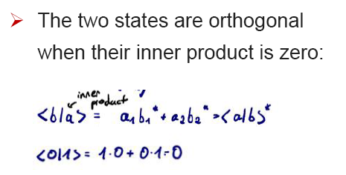
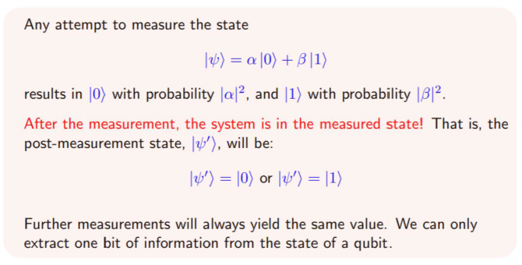
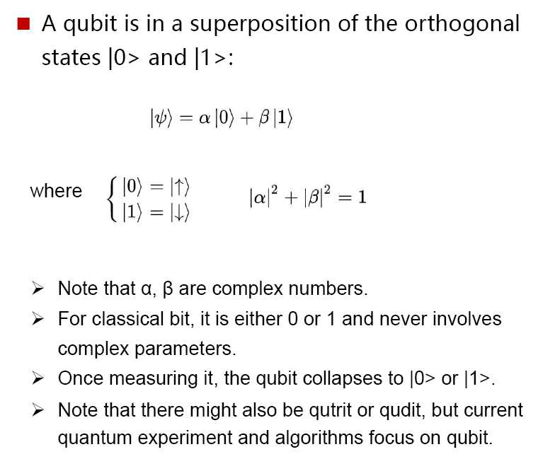
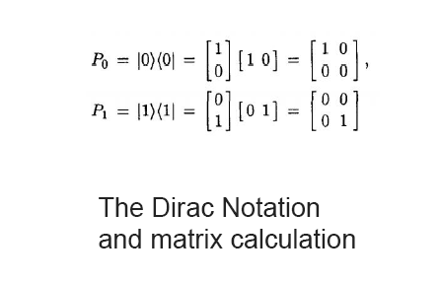
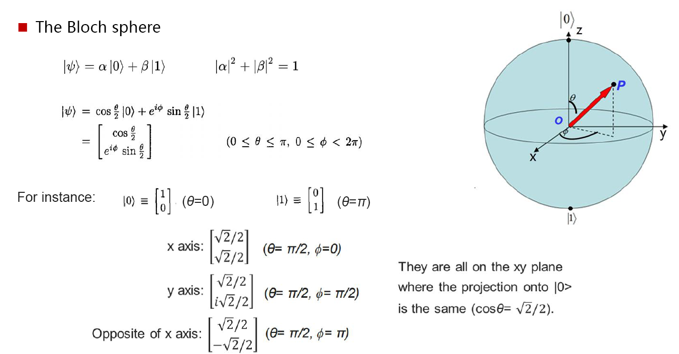
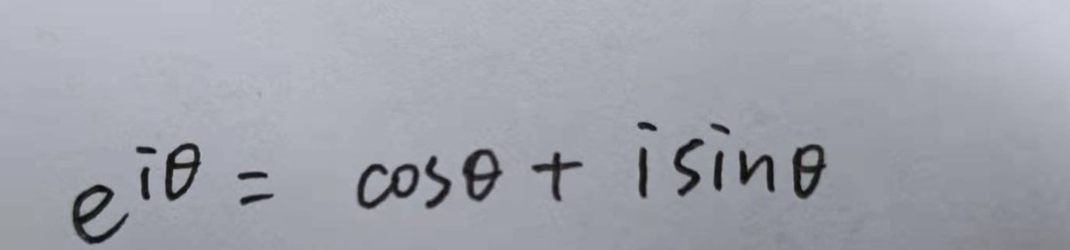
Qubit
欧拉公式

Slide 2
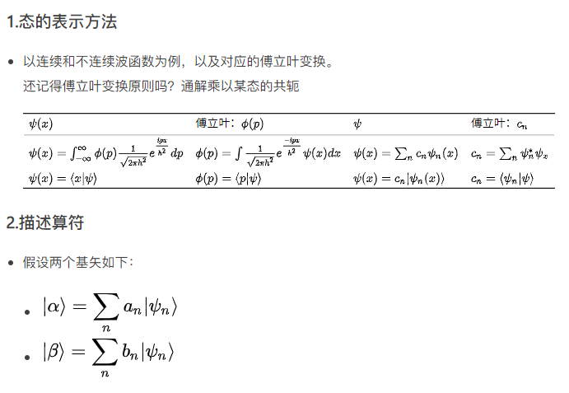
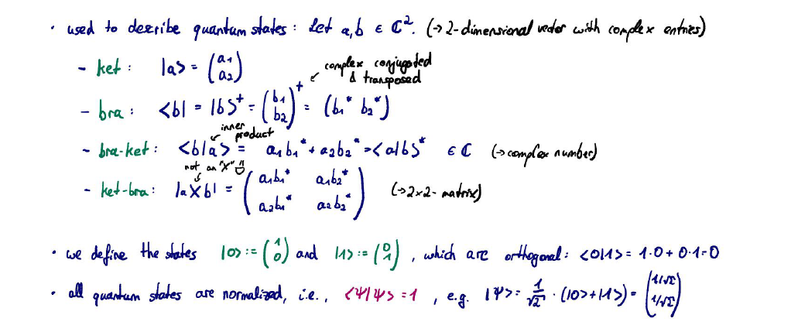
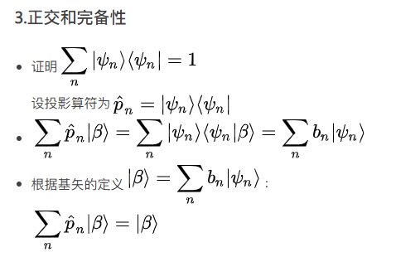
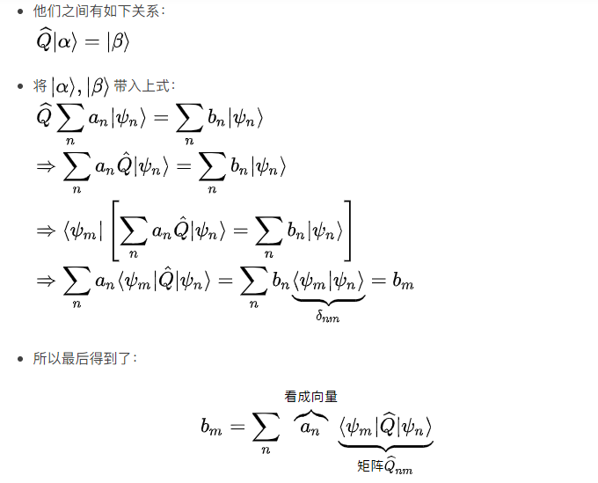
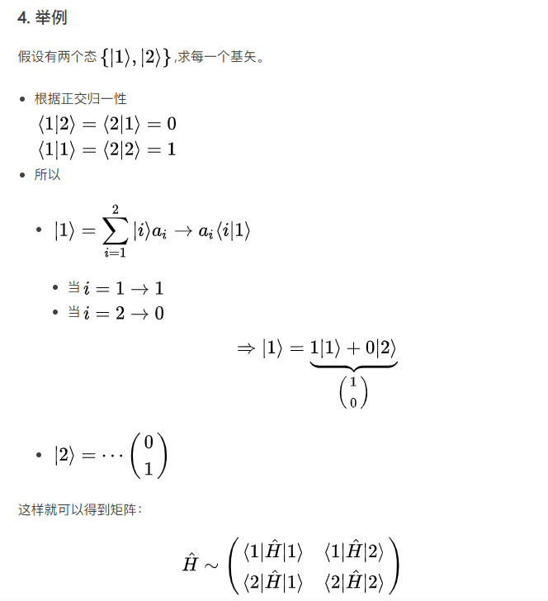
Dirac notation

Slide 3
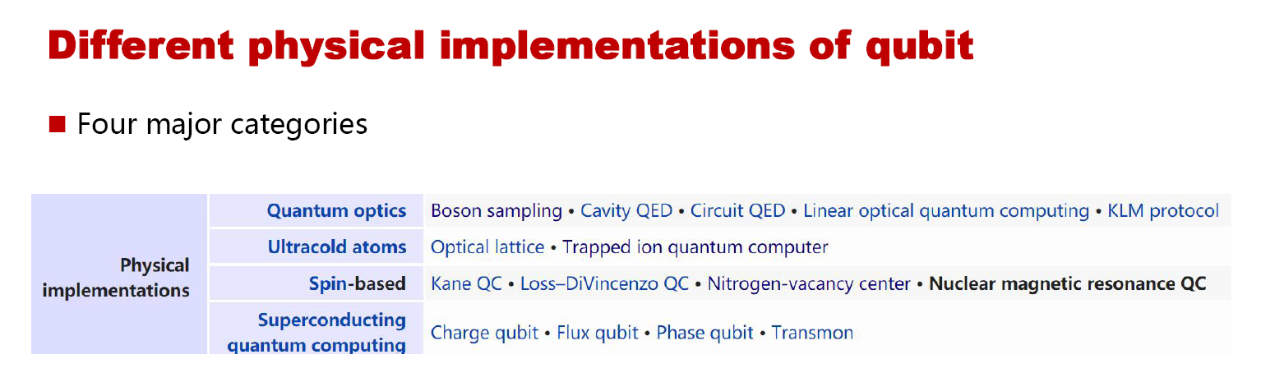
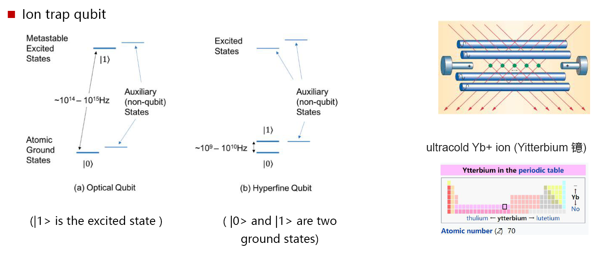
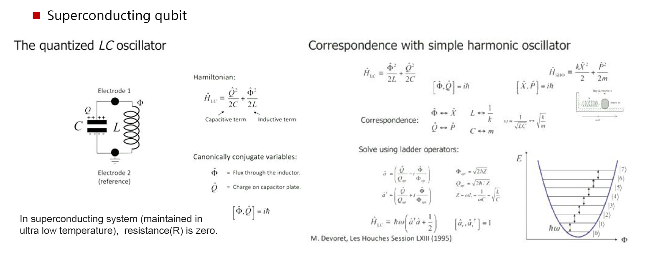
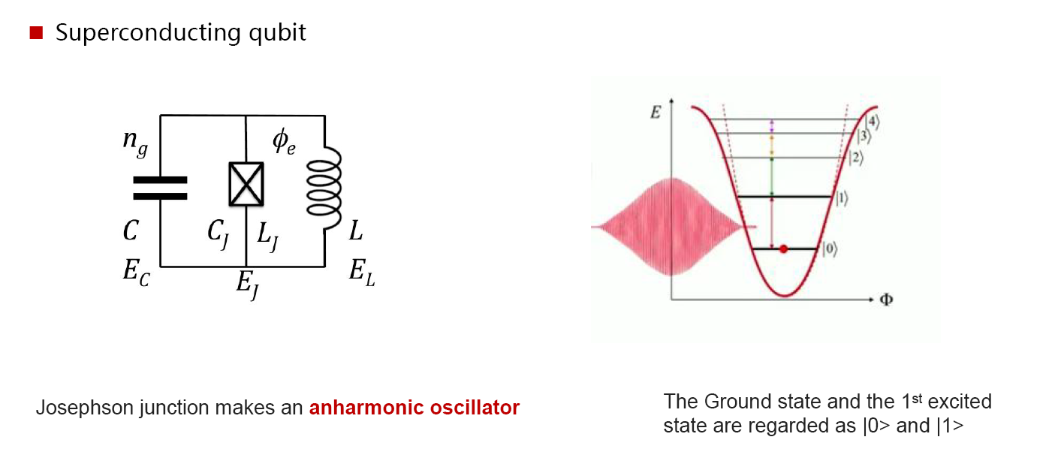
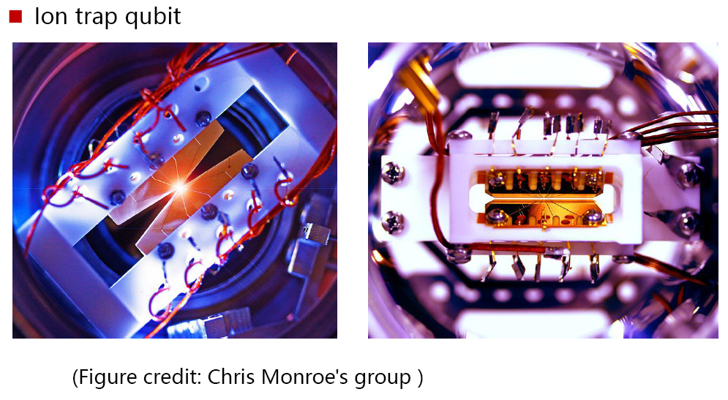
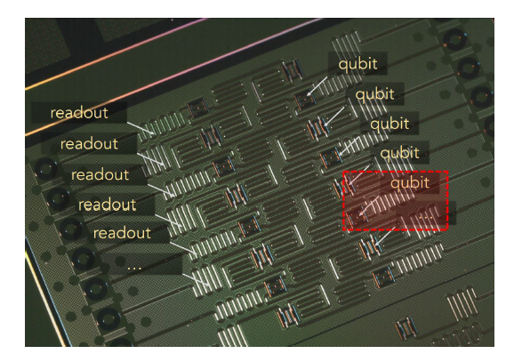
Physical Implement

Slide 4
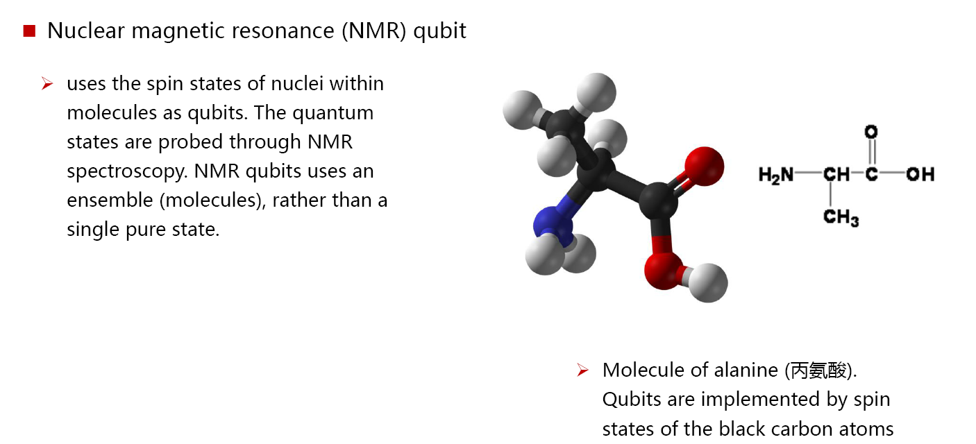
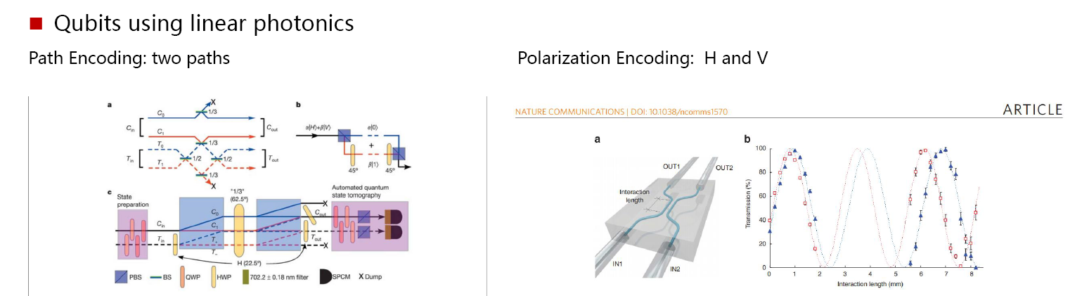
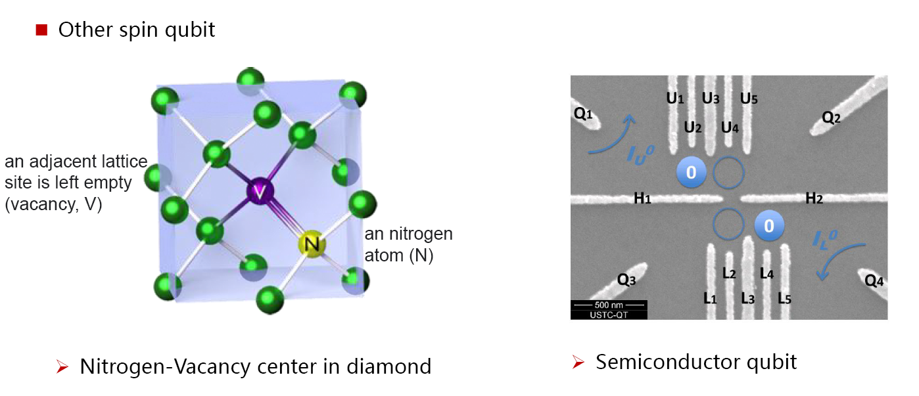
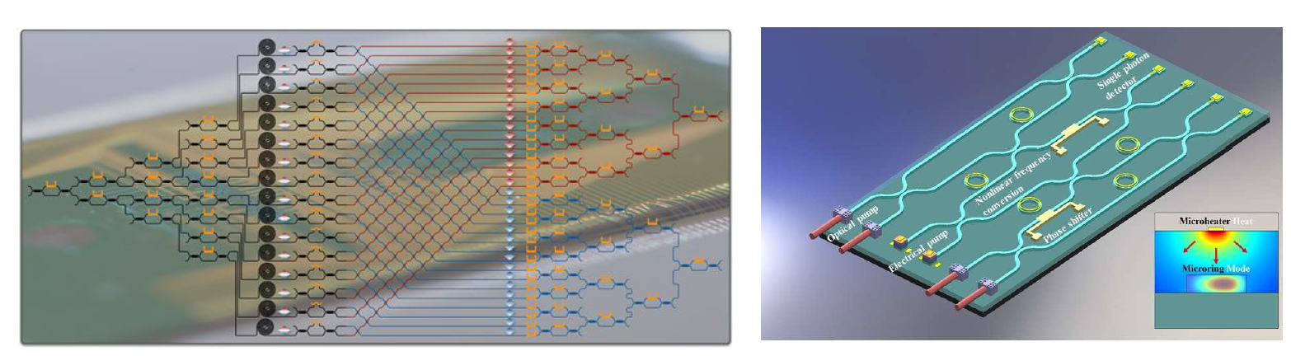
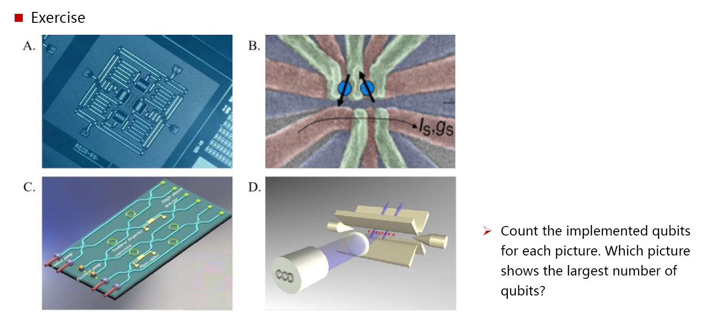
Physical Implement
Superconductor
4 qubit
Spin-based
2 qubit
Photonic qubit chip
3 qubit
Ion stap
8 qubit

Slide 5
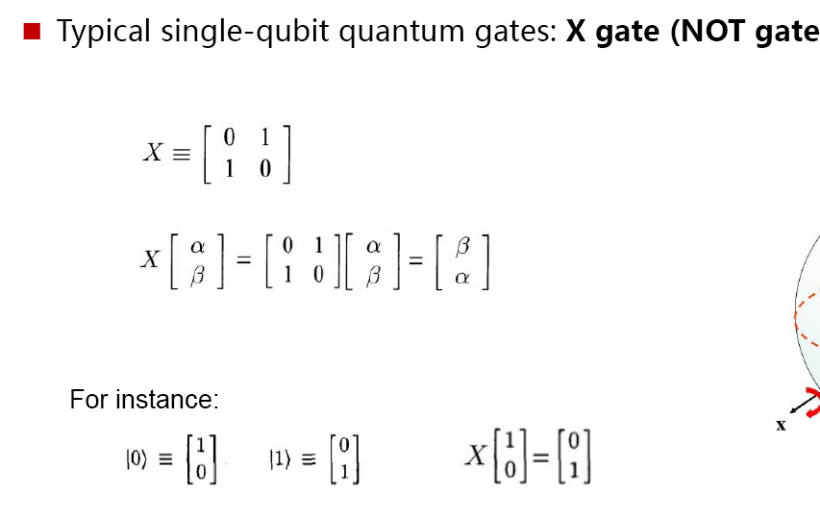
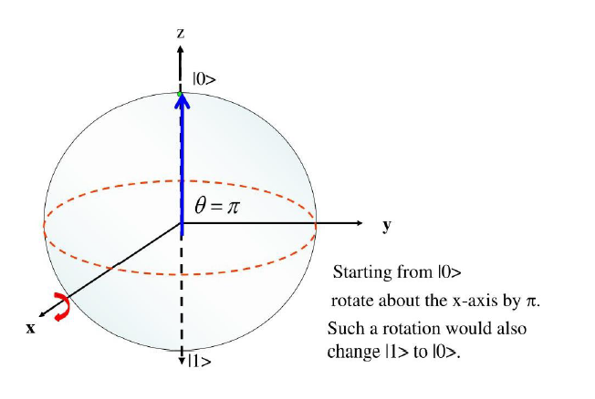
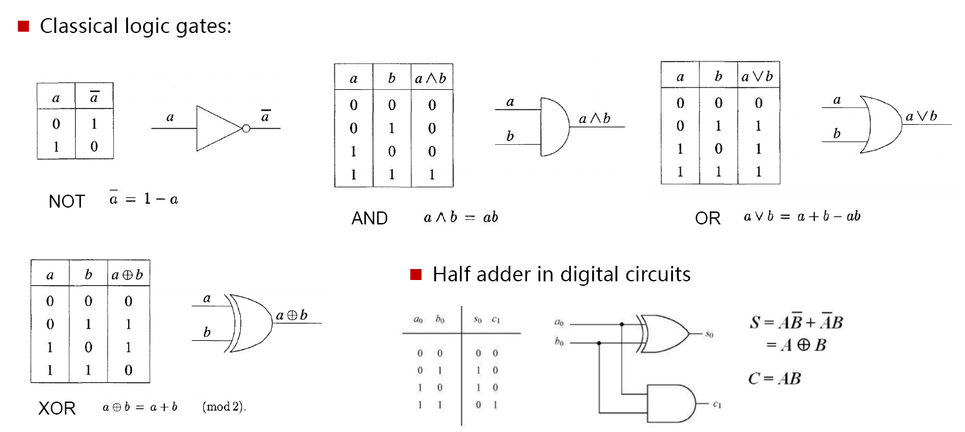
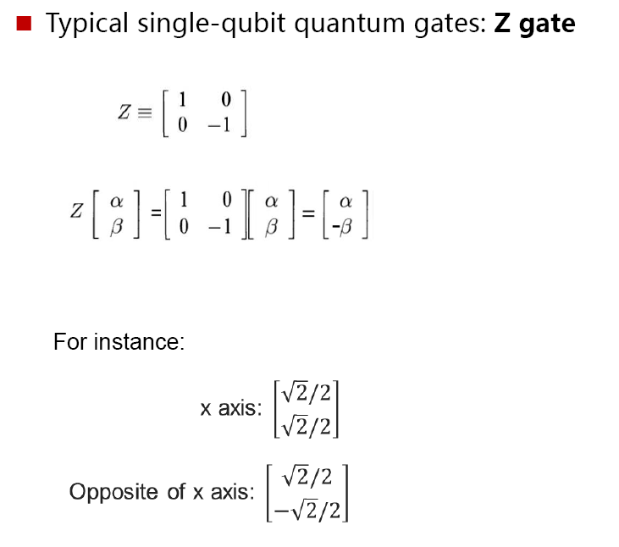
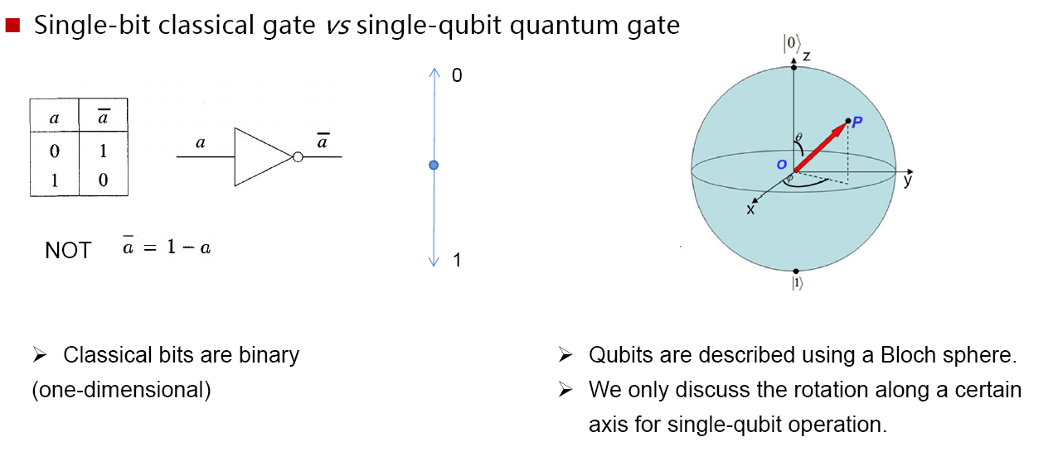
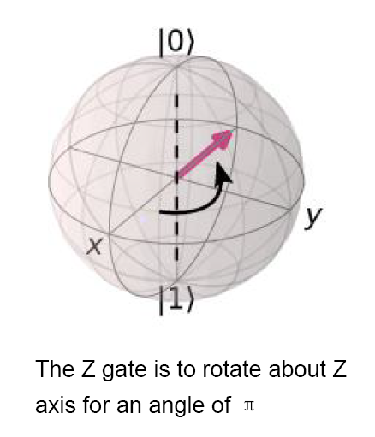
Quantum gates (single)

Slide 6
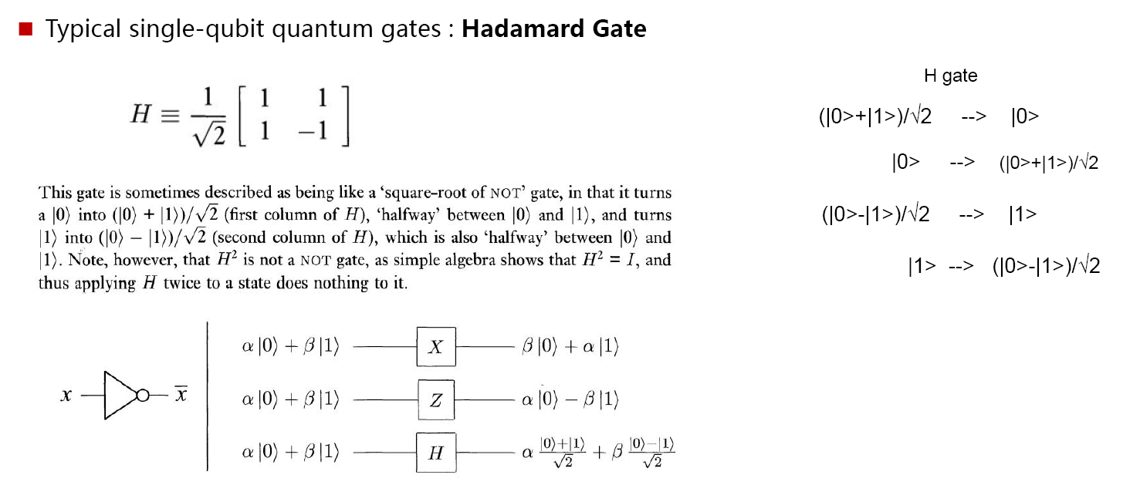
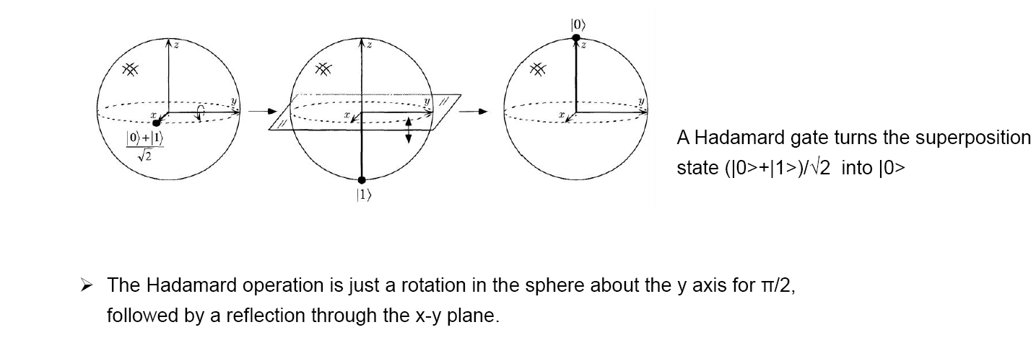
Hadamard gate

Slide 7
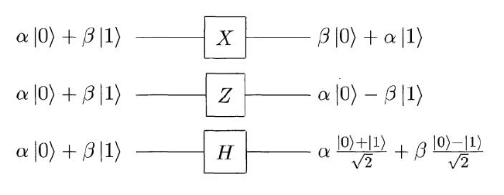
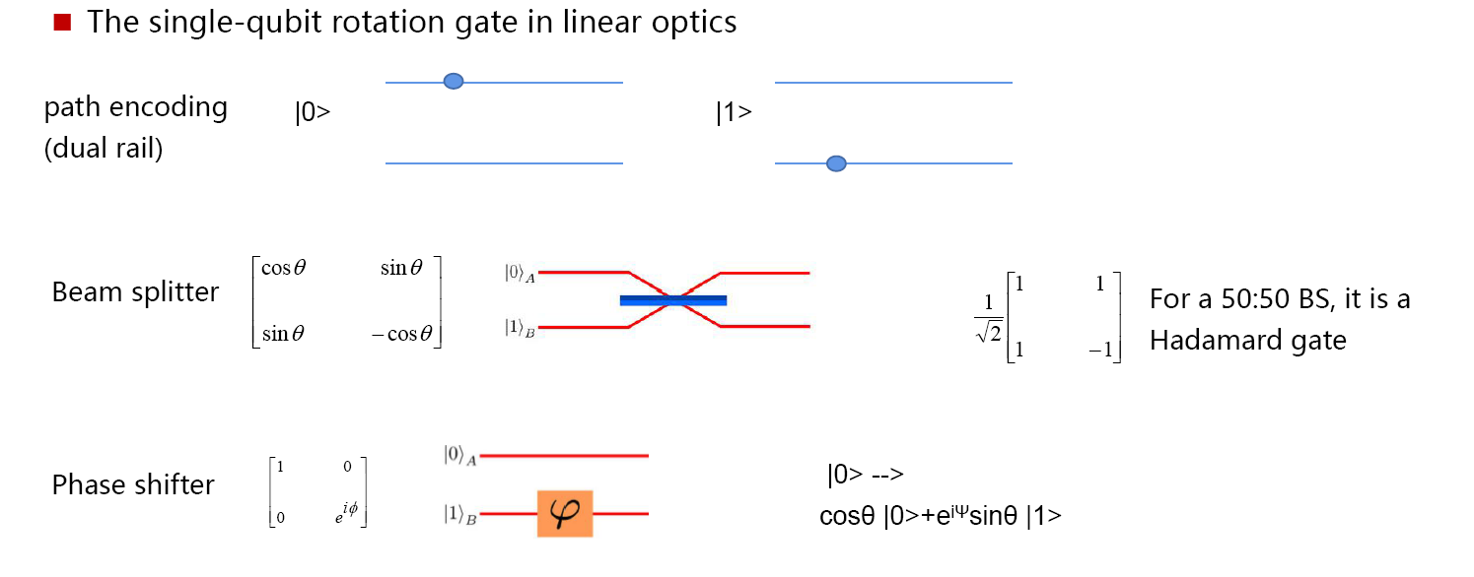
Implementation of gate

Slide 8
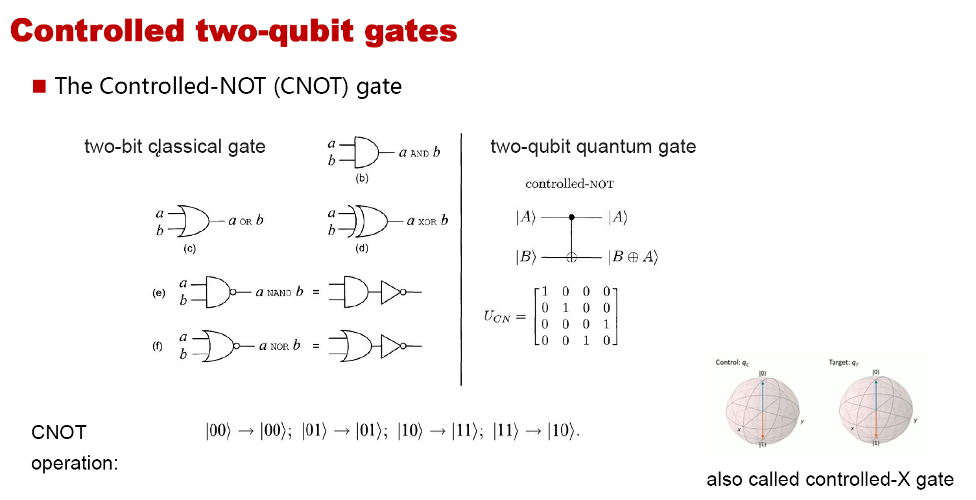
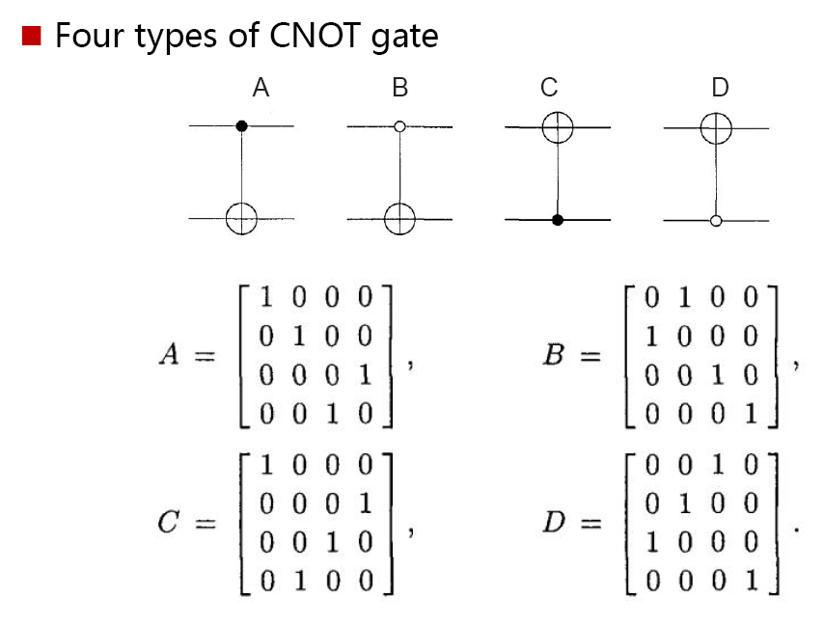
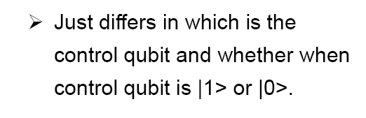
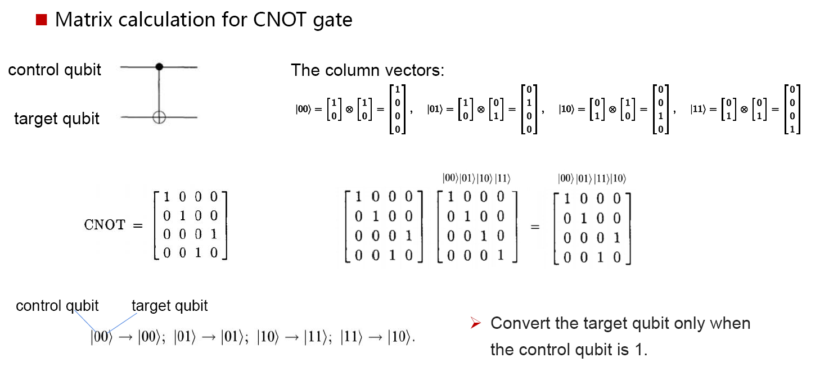
CNOT gate

Slide 9
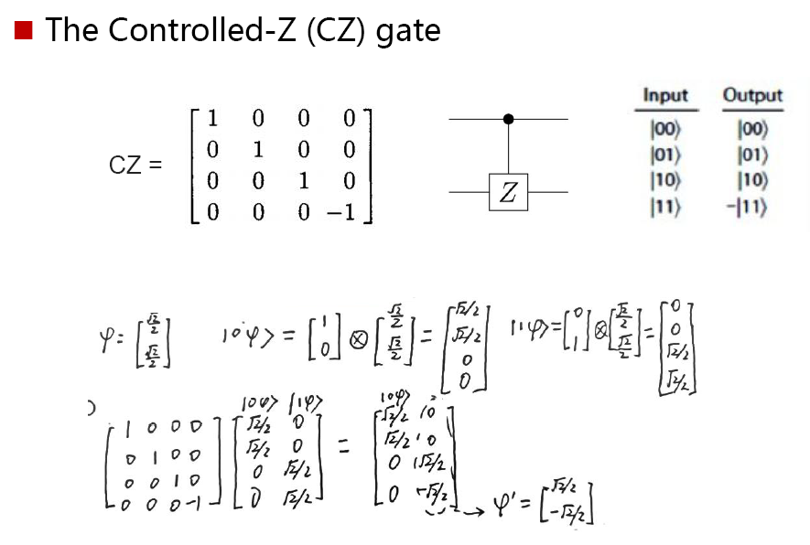
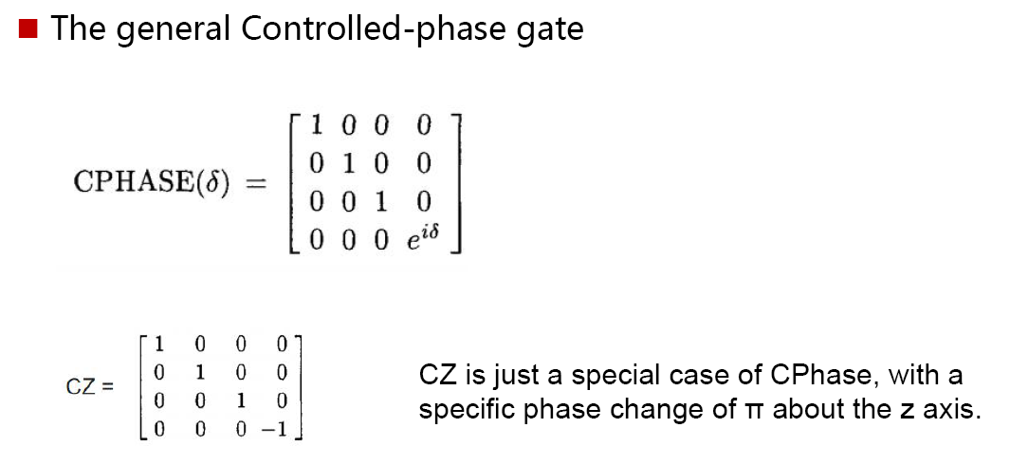
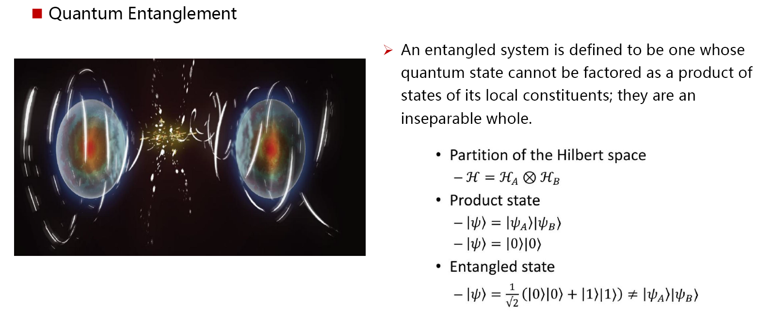
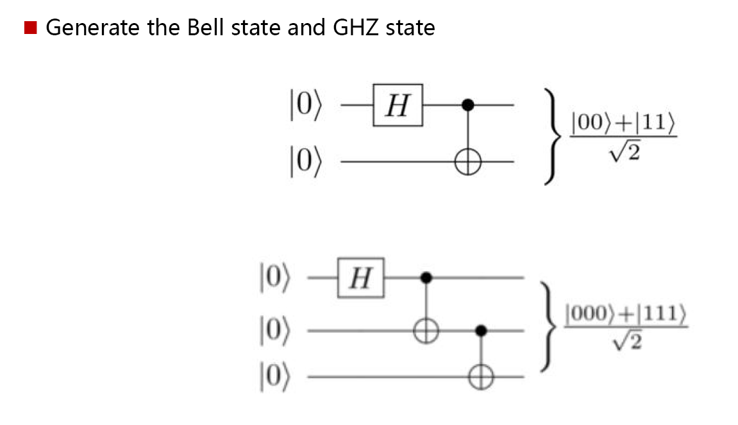
Other gates

Slide 10
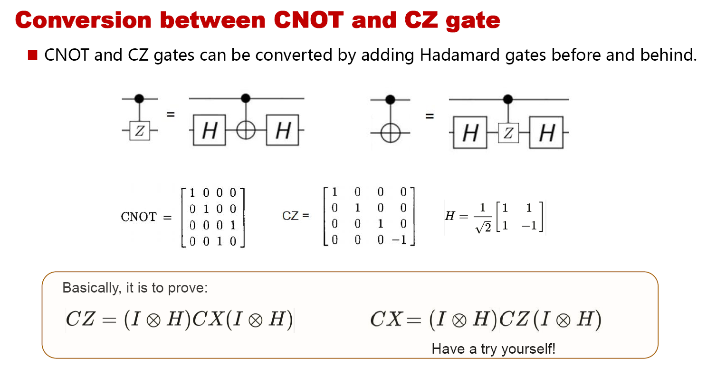
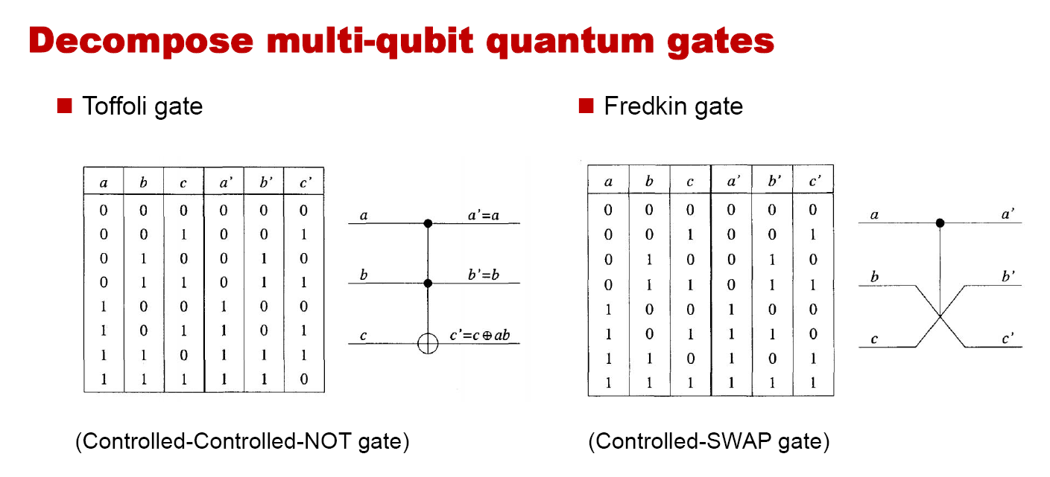
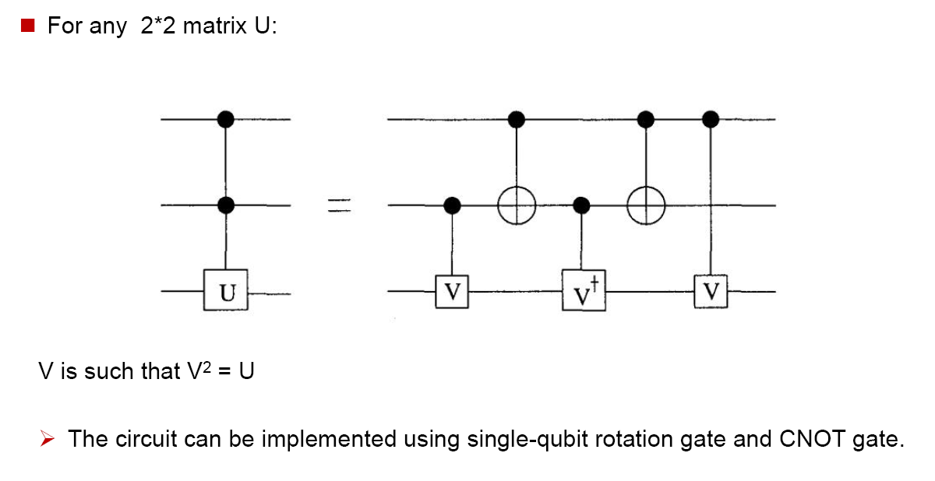
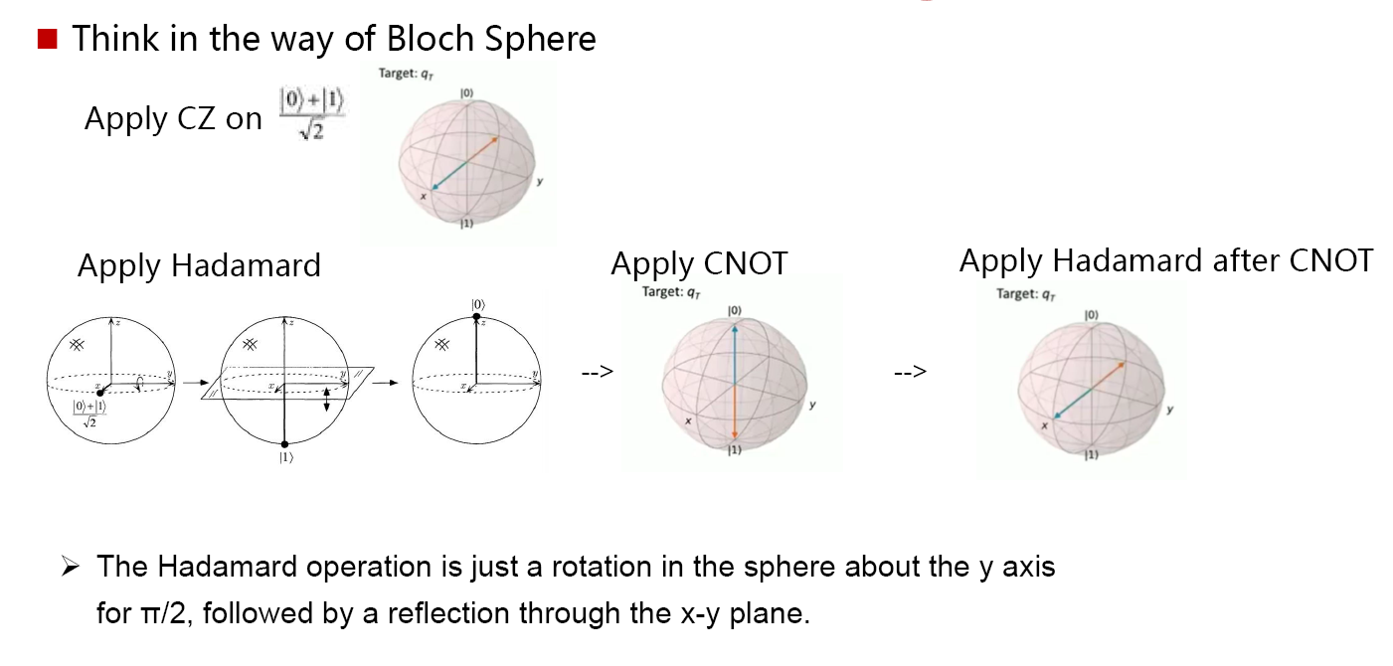
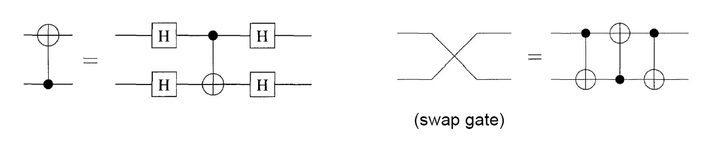
Conversions
Decompose

Slide 11
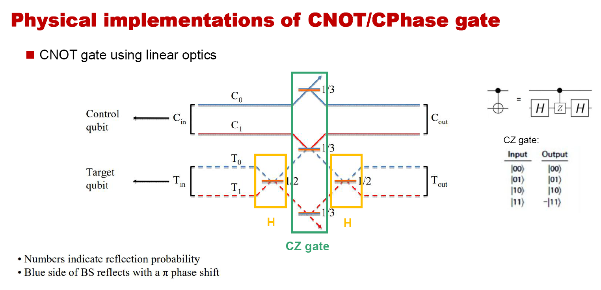
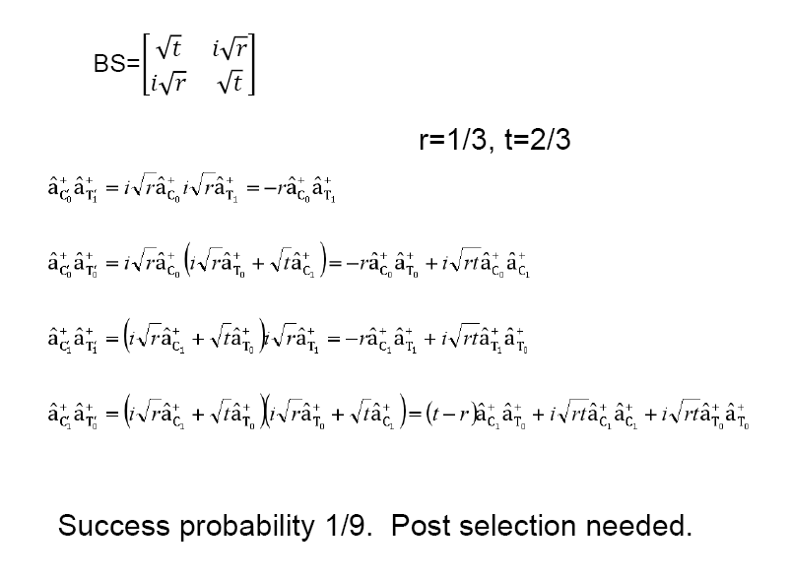
Physical implementation

Slide 12
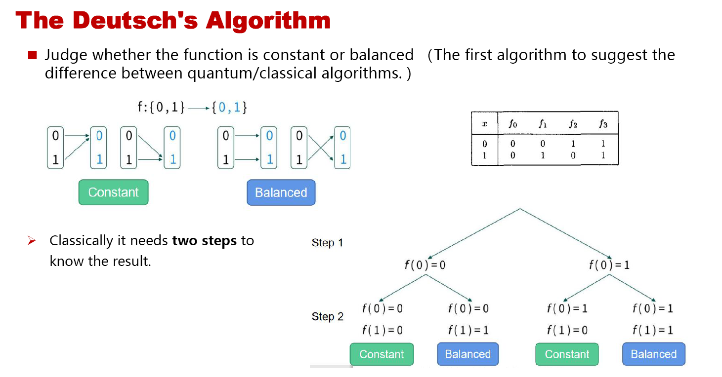
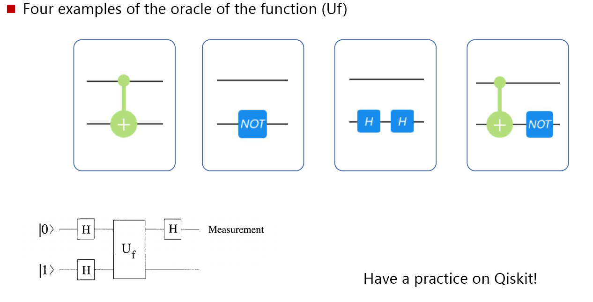
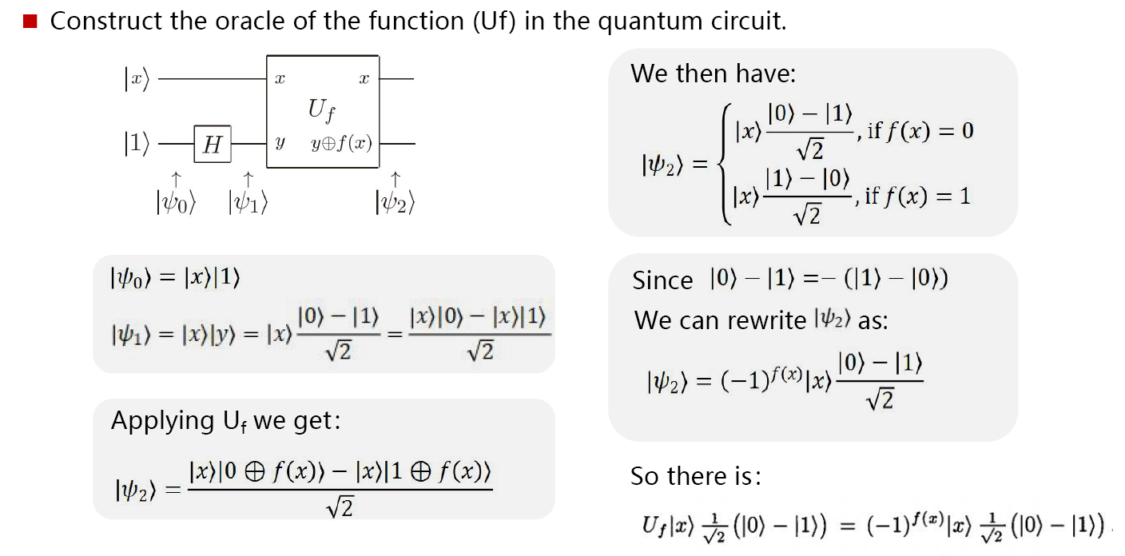

Deutsch Algorithm

Slide 13



Grover search

Slide 14




Grover search

Slide 15




Grover search

Slide 16



Grover search geometric interpretation

Slide 17




Grover search geometric interpretation

Slide 18


Grover search geometric interpretation

Slide 19





Exercise

Slide 20




Quantum Walk

Slide 21




Quantum Walk

Slide 22




Boson Sampling

Slide 23


Boson Sampling

Slide 24





Stochastic walk

Slide 25




Stochastic walk: Application

Slide 26





Fourier Transform

Slide 27




Development Fourier Transform

Slide 28




Development Fourier Transform

Slide 29




Quantum Fourier Transform

Slide 30




Quantum Fourier Transform

Slide 31


Quantum Fourier Transform

Slide 32



Inverse Quantum Fourier Transform

Slide 33




Quantum Phase Estimation

Slide 34



Quantum Phase Estimation

Slide 35




Shor algorithm

Slide 36



Shor algorithm

Slide 37



Shor algorithm

Slide 38





Shor algorithm

Slide 39





HHL

Slide 40





HHL

Slide 41



HHL

Slide 42


HHL

Slide 43





HHL

Slide 44




QSVM

Slide 45


QPCA

Slide 46




Quantum Annealing

Slide 47




Quantum Annealing

Slide 48




Quantum Annealing

Slide 49






Quantum Annealing & D-wave

Slide 50





QUBO

Slide 51




QUBO & Penalty function

Slide 52




Penalty function

Slide 53




QUBO & D-Wave

Slide 54




NISQ

Slide 55




VQE

Slide 56




VQE

Slide 57




VQE

Slide 58




VQE

Slide 59




Trotterisation

Slide 60





QAOA

Slide 61




QAOA

Slide 62




QAOA

Slide 63



Compare

Slide 64



Max-cut

Slide 65



QAOA circuits for different Hamiltonians

Slide 66




Optimization using Grover search

Slide 67






Quantum machine learning

Slide 68





Quantum machine learning

Slide 69




Quantum SVM

Slide 70





Quantum Feature Map

Slide 71




Parameter shift rule

Slide 72


Parameter shift rule

